Slide 1
TWITTER SENTIMENT ANALYSIS
Prajakta Sirame Pooja Bera

Slide 2

Sentiment Analysis ?
Sentiment Analysis is the process of determining whether a piece of writing is positive, negative, or neutral.
Also referred to as opinion mining, it makes our goal to determine whether
the data(tweet) is positive, negative, or neutral.

Slide 3

Why is Sentiment Analysis Important?
In public opinions eg:
Is this product review positive or negative?
Is this customer email satisfied or dissatisfied?
Based on a sample of tweets, how are people responding to this ad campaign/product release/news item?
How have bloggers' attitudes about the president changed since the election?

Slide 4
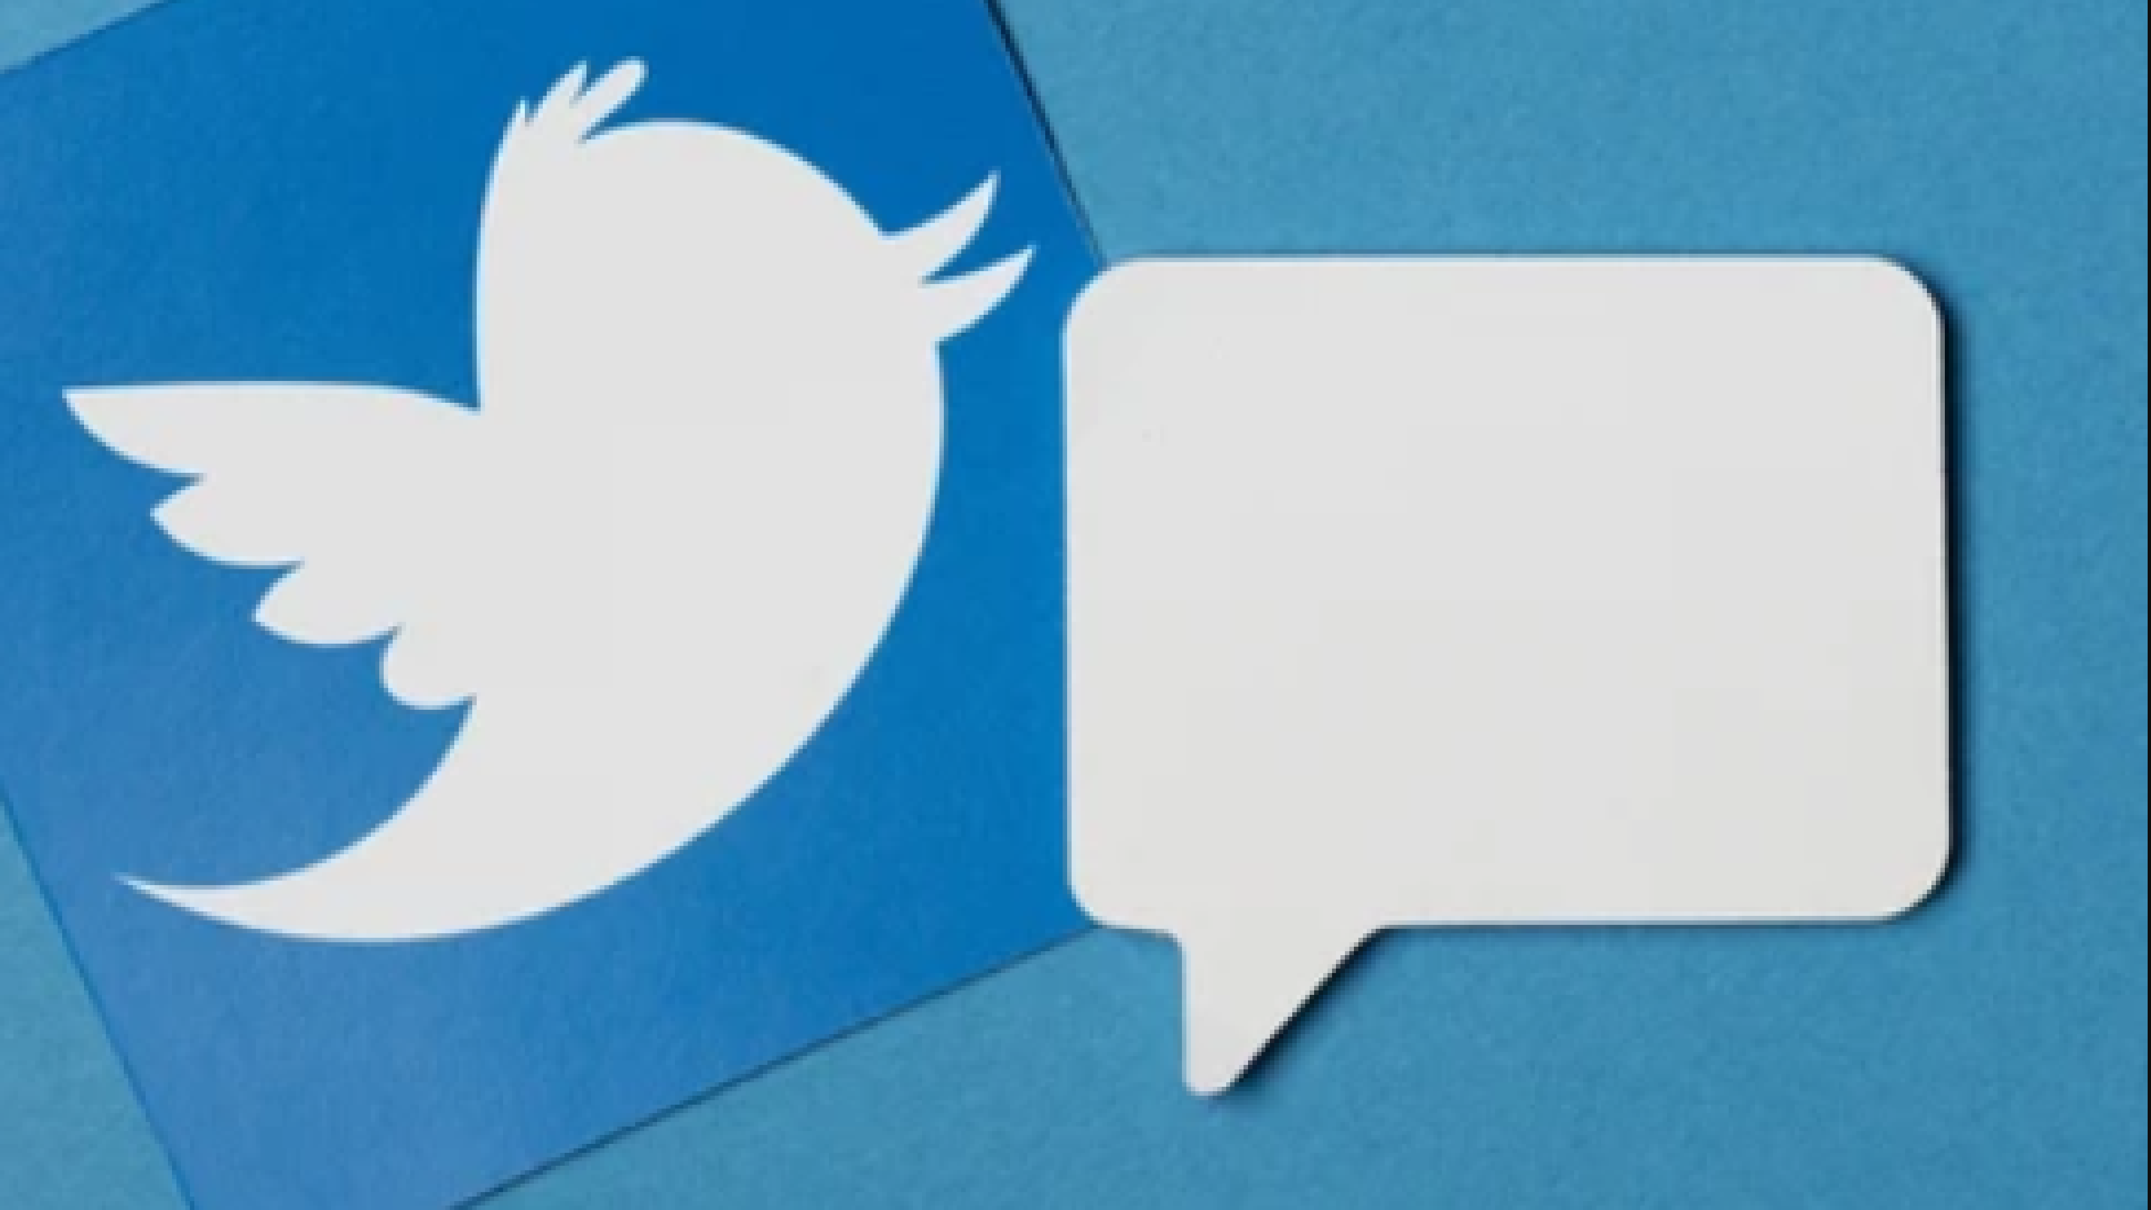

Why Twitter Data for Sentiment Analysis?
Popular microblogging site.
Short Text Messages of 140 characters. 240+ million active users.
500 million tweets are generated every day.
Twitter audience varies from common man to celebrities.
Users often discuss current affairs and share personal views on various subjects.
Tweets are small in length and hence unambiguous.

Slide 5



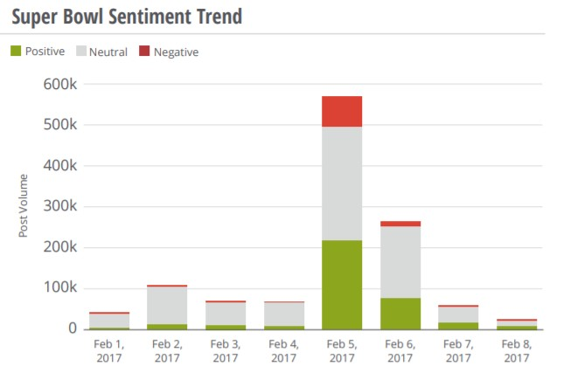
The Super Bowl
The Super Bowl is the biggest sports night in the U.S., and also one of the biggest nights on Twitter, as millions of people live-tweet the game and commercials.
When millions of consumers react to an important event in real-time, you can be sure that a lot of emotion will be involved. Consumer reaction led to tweets from Patriots and Falcon fans.

Slide 6



Election of Donald Trump
The election of Donald Trump in November 2016 sparked social media madness. People were shocked, fearful, angry, sad, and happy. And Twitter captured the bulk of it.
When something important happens, Twitter is the social platform that dominates — and its users tend to express their unvarnished opinions about whatever just occurred. As a result, Twitter is the best place for brands to analyze real-time reactions and understand consumer sentiment as insights unfold.

Slide 7
Thank
You

